Slide 1

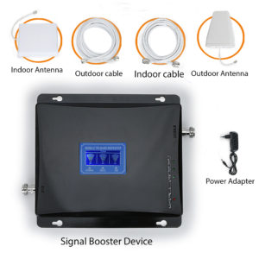
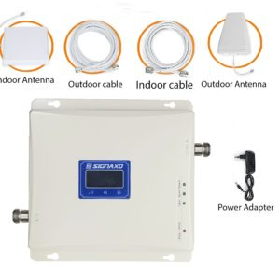
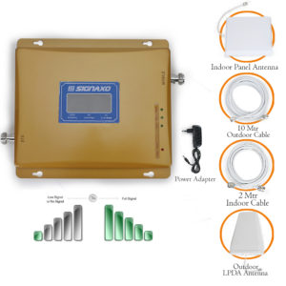
Signaxo Signal Booster
Signaxo is one of the leading company in cell phone booster. Our company provides you best quality mobile signal booster and accessories, which makes your life more easy and comfortable. Our team feels that you are facing so many problems regarding mobile signals. That’s why we are providing services all over the globe.

Slide 2
About Us
SIGNAXO is a global provider of quality Mobile Phone Signal Boosters/repeaters and accessories, involved in all aspects of everyday life. The company is the leading provider of Mobile Signal Boosters, supplying distribution to numerous countries and serving a large number of people worldwide.
With a proven heritage of stability, performance and value, SIGNAXO has curated a portfolio of products that meet the weak/poor cell phone signal booster needs of all individuals. Now, as the connected lifestyle continues to evolve, the company is expanding today to exceed the demands of tomorrow. To resolve the problems related to the weak signals of mobile phones we provide a Mobile Signal Boosters because we know the value of money and valuable time. We have many customers across the world as our product gives satisfactory results. Our company provides quality assurance with a 1-year warranty of mobile signal booster and replacement.

Slide 3
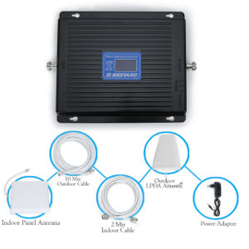
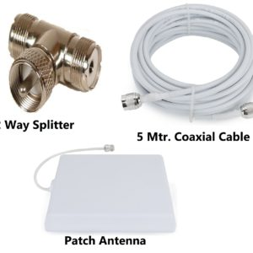
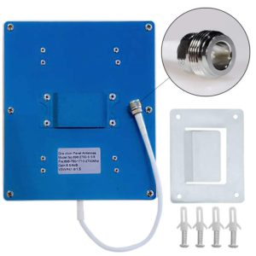
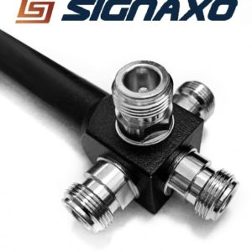
Our Products
SX – Jio Connect 2000 Triband Kit
SX – Plus 2000 Triband Kit
SX – Premier 3500 Triband Kit
SX-splendid 3200 Triband kit
SX-premier 3500 Triband kit
SX-supreme 4000 Triband kit
SX- Coaxial Cable 40 Mtr
SX- Dual Extender Combo (2-Way Splitter + Patch Antenna + Five Mtr. Combo)
SX- Coaxial Cable 30 Mtr

